Slide 1
SMART4ALL
Beyond the SAE Initiative, European Digital Innovation Hubs and SMART4ALL Marketplace
Boris Antić, University of Novi Sad, Faculty of Technical Sceinces, Novi Sad, Serbia

Slide 2
Overview
SAE initative
Digital transformation
Digital Innovation Hubs
SMART4ALL Marketplace
EDIH
Enterprise Europe Network and beyond

Slide 3
Smart Anything Everywhere
Digitizing European industry
  ensure that any industry in Europe – big or small, wherever situated and in whichever sector – can fully benefit from digital innovations to upgrade its products, improve its processes and adapt its business models to the digital age
Within CSA project Smart4Europe2
4 components:
  Digital Innovation Hubs (DIHs)
  Partnerships & Platforms
  Skills & Jobs
  Regula­tory Framework

Slide 4
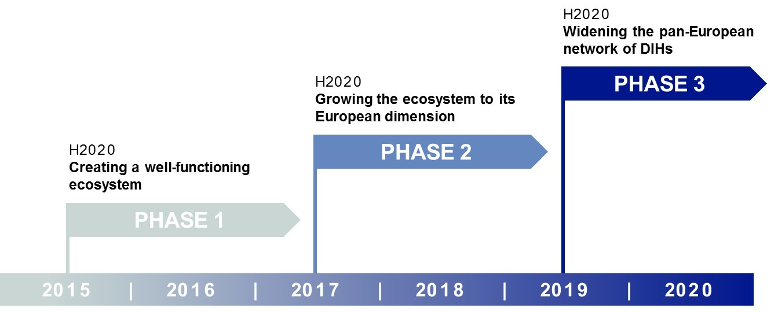
About digital transformation
Inclusion of innovative digital technologies
  Cyber-physical and embedded systems
  Customised Low Energy Computing powering Cyber-Physical Systems and the Internet of Things
  Flexible and wearable electronics/Organic Large Area Electronics
  Widening Digital Innovation Hubs

Slide 5
What is a DIH?
The DIHs act as a one-stop-shop, providing their customers with:
  access to digital technologies and competences,
  infrastructure to test digital innovations,
  training to develop digital skills,
  financing advice,
  market intelligence and
  networking opportunities.
Every company in Europe should have a DIH at a working distance
At least one in every region in Europe

Slide 6
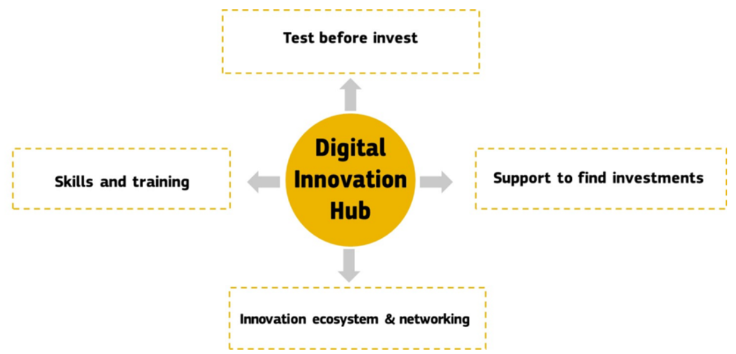
Digital Innovation Hub
Services
Repository of tools
Knowledge
Networking
Funding opportunities

Slide 7
One stop shop?
More likely: one of the stop shops
Reason:
  Overwhelming maintenance
  Overlaping duristictions (STP, Incubators, Chambers of Commerce, TTC, EEN, VCF...)
  Historical context (prior DIHS or not)
  Need for technology focus
Successful strategies always included specialization

Slide 8

SMART4ALL Marketplace
Marketplace as a Service Concept is one the cornerstones of SMART4ALL
What is it ? A novel one-stop-smart-shop for experts and non-expert third parties seeking (open-source mainly) ICT technologies
Unique selling point: AI based match-making and
collaboration activities will be hosted in the MaaS
What is its main target ? reduce the development time of an startup /SME/mid-cap that is doing business in one of the four SMART4ALL thematic areas

Slide 9
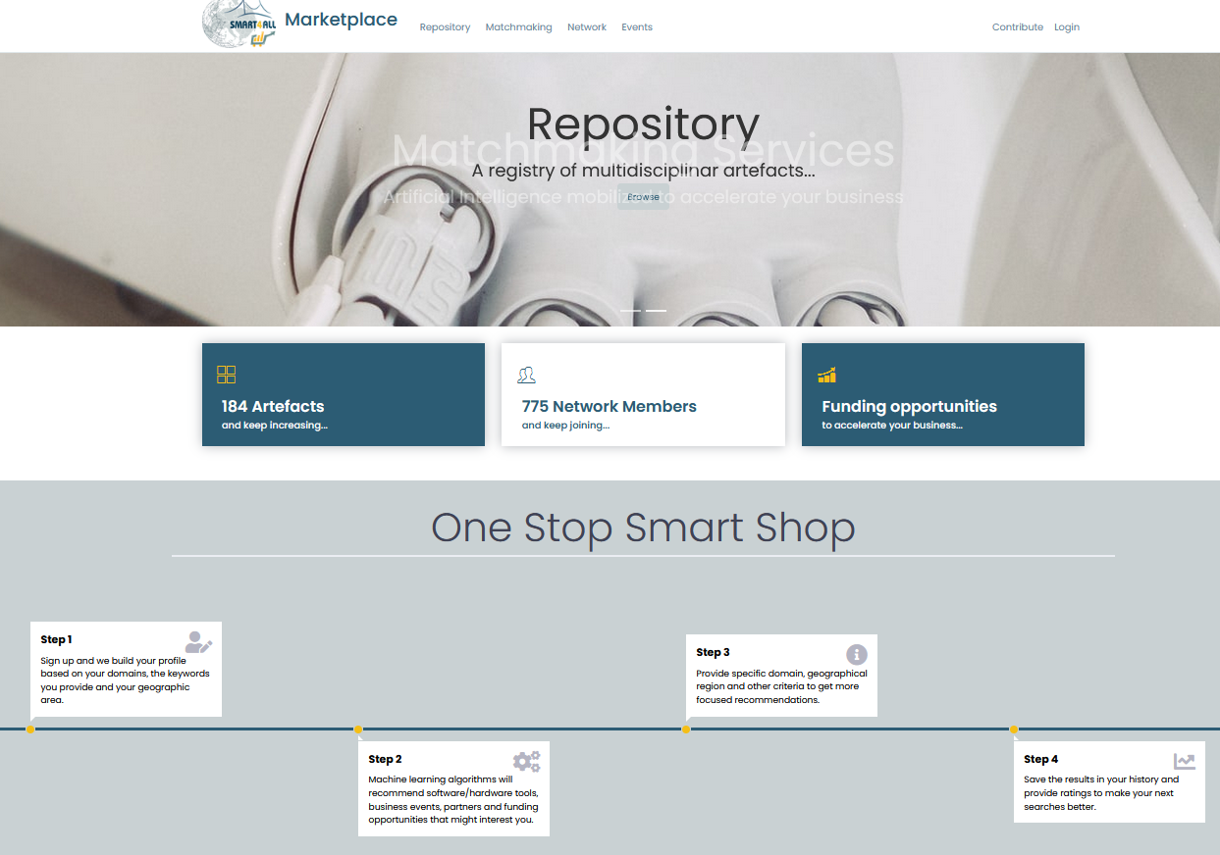
The MarketPlace SW infrastructure
https://marketplace.smart4all-project.eu
Marketplace follows the microservices paradigm where all the functionality is given as a set of loosely coupled services powered by containerization technology
MaaS includes:
Open and proprietary cloud services
Open and proprietary computing and communication platforms
Open-source tools and middleware frameworks
Open-source design tools Training (model-based) open course

Slide 10
Beyond the SAE
Iniative ended in December 2021 !!!!!!
Why are we still talking about it?
  Still some projects like SMART4ALL
EDIH – the next step
  Yes, but only for EU Member States
  Widening strategy has been abandoned
  Criteria:
  1. have been designated by their country as candidate EDIH
  2. have submitted a proposal to the EU call
  3. have been evaluated above threshold

Slide 11
EDIH
Context:
  Digital Transformation Accelerator
  Digital Europe Programme work programme (DIGITAL)
  JRC’s practical handbook with good practices on investment in Digital Innovation Hubs
  Regional Strategy for Research and Innovation for Smart Specialisation
What is different:
  50% provided by the EC, 50% by Member States → Ministries select EIDHs to receive funding
  Consortium of institutions instead of a single entity
  Not-for-profit objective
  It will last for 7 years (3 + 4 possible extension) 2021-2027

Slide 12
Specifics
At least one AI EDIH in every Member State
At least one agri-food DIH in every Member State
Combination of technology and management know-how
Specialization is recommended
National vs regional EDIHs
Cross-border transnational hubs – INTERREG
(borders can include sea)
Predefined budget for each country

Slide 13
Candidate vs Selected EDIH
Member States are asked to designate their candidate
EDIHs and commit to co-finance them
In year 1 of the Digital Europe Programme, the European Commission ran a restricted call for proposals, reserved for the designated EDIHs
Croatia:
  ADRIA (Rijeka): 7 services
Slovenia:
  DIGI-SI (Maribor): 70 services

Slide 14
Year 2 of the EDIH (2022)
Member States which have not used the entire budget from the DIGITAL programme and still have a “gap” in the network, a second restricted was launched
Reserved to the pre-selected candidate EDIHs which will extend the geographical/technological coverage of the network and were not selected in year 1, for instance because they did not meet the evaluation threshold. All the selected EDIHs will get a
contract under the same conditions.

Slide 15
Region and Europe
Croatia:
  ADRIA (Rijeka)
  AI4Health.Cro (Zagreb)
  CROBOHUB++ (Zagreb)
  JURK (Sisak, Zagreb, Rijeka)
Slovenia:
  DIGI-SI (Maribor)
  SRC-EDIH (Novo Mesto)
Europe total:
  137 EDIHs (4 Greece, 7 Bulgaria, 13 Italy, 14 Germany, Canary Islands and Reunion)
  188 Candidate EDIHs

Slide 16
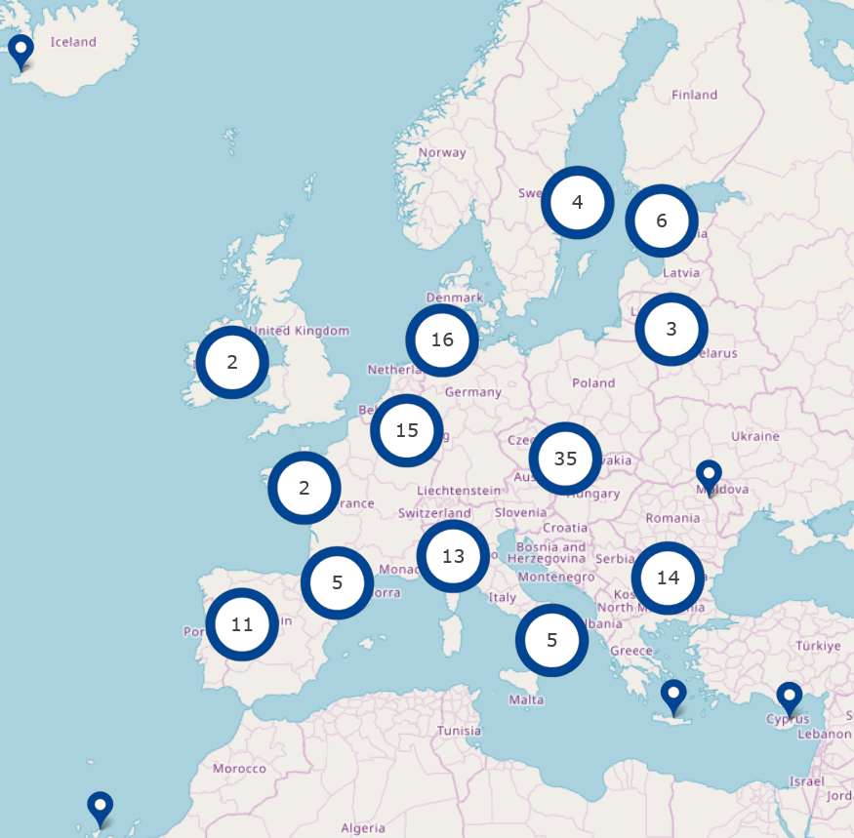
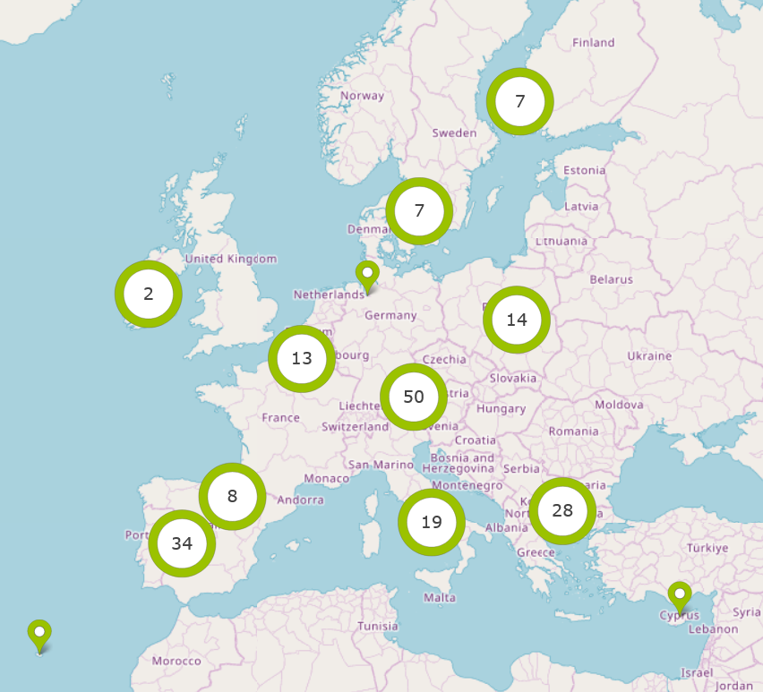
Selected vs Candidate EDIHs

Slide 17

Year 3 of EDIH (2023)
In case the network of EDIHs will not show a balanced geographical/technological distribution across the Union, an open call could be launched to ‘patch the holes’ and expand
coverage
The specific conditions of this call will be detailed in a new work programme
The selected EDIHs will get a contract under the same conditions
Sounds like a plan!

Slide 18
Aftermath
EDIH strategy takes monitoring and performance evaluation very seriously
  15 to 30 “train the trainer” event per year, in the form of online workshops of 2-4
  hours each
  2 to 4 online or physical events per year for sharing best practices within sub-
  networks, each event 4-8 hours
  one annual EDIH event per year, in the form of 2-day event in hybrid format (physical
  and online)
  one-off collaborations: on average 5-20 % of your customers will need support from
  other EDIHs, and 5-20% of the total amount of customers you can help will come
  through referral of other EDIHs.
Some have failed already and gaps are visible across the EU

Slide 19

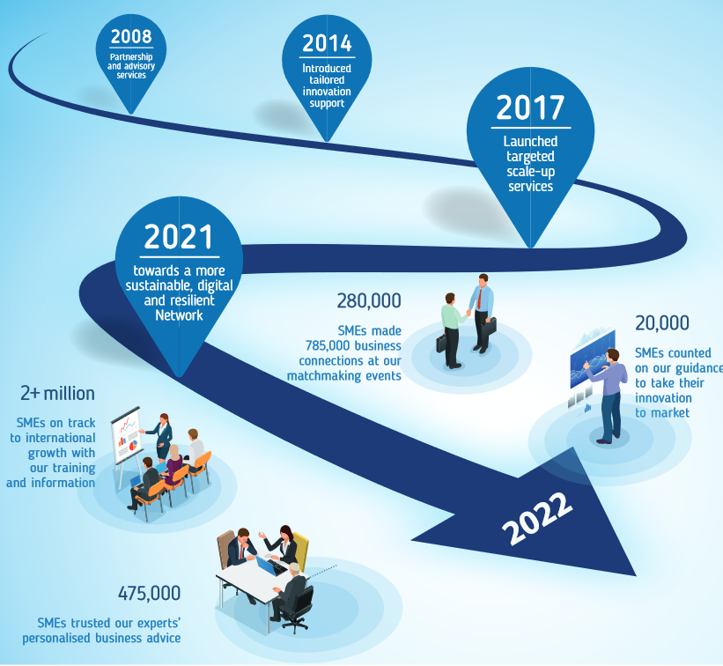
Enterprise Europe Network
https://een.ec.europa.eu/
Helps businesses innovate and
grow on an international scale
EEN-EDIH Synergy
  A chance for the Western Balkans?

Slide 20
Summary for the Balkans
DIH that are not EDIHs will continue to offer services
  Strong legacy – dubious sustainability (gap in financing)
Many DIHs are clustering to fill in the gaps
  Synergies with other initiatives and institutions
A zoo of entities offering services to SMEs
  Where to go if you need something?
The market will determine the survivors, not committees
  It’s about people, expertise and hard work

Slide 21
Thank you for your attention – Questions?

